Slide 1
Introduction to Preschool STAC Processing
STAC Homepage: https://www.oms.nysed.gov/stac/
Rev. May 2023

Slide 2
STAC
System to Track and Account for Children (STAC)
The STAC and Medicaid Unit is the unit within the NYS Education Department responsible for processing requests for Commissioner's approval for reimbursement.
This includes reimbursement approval for the costs of providing services to preschool and school-age students placed in special education programs at public and SED-approved private schools, special-act school districts, BOCES, and at state-supported and state-operated schools for the deaf and blind.
It also includes reimbursement approvals for students who have been determined to be homeless or runaway youth and for education services provided to incarcerated youth.

Slide 3
Did You Know? STAC Utilizes Two Different Systems
EFRT STAC Online System
SED FTM Secure File Transfer Manager
Approvals submitted one at a time, processed immediately.
Used to access real time data.
Used by counties and school districts to verify claims.
Allows submission of data in a consistent, standard format for each placement type.
Approvals submitted in large batches, processed overnight.
Used to retrieve reports generated by the STAC/Medicaid Unit.
Used by most counties to submit preschool AVLs.
Provides flexibility to securely
submit documentation containing PII in many formats.
Used to submit claims for reimbursement

Slide 4
STAC ACRONYMS AND COMMON TERMS
AVL Automated Voucher Listing
CPSE Committee on Preschool Special Education
FTE Full Time Equivalent
IEP Individualized Education Program
LEA Local Educational Agency
P-12 NYSED Special Education Office
SEIS Special Education Itinerant Teacher Services
STAC System to Track and Account for Children

Slide 5
Section 4410 Preschool Reimbursements
PRESCHOOL SERVICES:
CENTER-BASED SERVICES
SEIS SERVICES
RELATED SERVICES
TRANSPORTATION
PRESCHOOL EVALUATIONS
ADMINISTRATIVE COSTS:
CPSE ADMINISTRATIVE COSTS
COUNTY ADMINISTRATIVE COSTS

Slide 6
Basic Process – Preschool Services and Evaluations
CPSE evaluates, determines disability and service needs
Programs are approved by NYSED Office of Special Education
Approved Child Evaluation or Service Record on STAC System
County submits STAC record, contracts / pays providers
Rate is added for programs, services
County verifies services delivered and paid to generate 59.5% reimbursement

Slide 7
Electronic Record Access
There are two systems important to STAC reimbursement:
STAC Online (EFRT) System
Employee Form: https://www.oms.nysed.gov/stac/forms/stac_access_form.pdf
Consultant Form: https://www.oms.nysed.gov/stac/forms/stac_access_form_consultants.pdf
Review, add, amend or verify approvals (providers review only).
User IDs must be authorized by Municipality Representatives.
User IDs and passwords must not be shared.
STAC Unit can suspend rights when aware of violations.
County Super User can renew or suspend users directly on EFRT.
SED Secure File Transfer Manager (FTM)
Authorization Form: https://www.oms.nysed.gov/stac/forms/stac-603_form_authorization_ftp.pdf
Submit bulk files – format available on STAC website.
Download STAC-3 amendment reports, summary files, and other reports.
Register and access through SED FTM web client.
Or access through FTP client using SFTP protocol.

Slide 8
Protecting STAC Data and Personally Identifiable Information (PII)
Family Educational Rights and Privacy Act (FERPA), Health Insurance Portability and Accountability Act (HIPAA), NYS Personal Privacy Protection Law and other statutes all require that PII is kept secure and only shared on a “need to know” basis.
Exchanging student data with the STAC Unit:
SED FTM is the most secure method for transmitting documentation with PII.
Fax during business hours and advise recipient when will be sent.
Emails with PII other than STAC ID need to be encrypted with password sent separately.
Paper documents sent US Mail 1st class/priority, or other service with tracking (e.g., UPS, FedEx, DHL).
Use the STAC Online (EFRT) System and FTP site – log out when not active.
When calling STAC Unit be prepared with your STAC Online User Code and password to confirm authorization to share data.

Slide 9
STAC-703 Form: Child Information Change Form
Located on STAC website under Forms.
Submit form to request changes to a child’s name or other identifying information.
Municipality Representative may sign form.
After form is completed and signed:
Upload form to your county’s SED File Transfer Manager (SED FTM) inbasket.
Send Email notification to OMSSTAC@nysed.gov to request processing.
Email should include name of form, SED FTM location and filename.
DO NOT include personally identifiable information (PII) in email nor filename. STAC-ID is acceptable.
DO NOT upload any additional supporting documentation (e.g. adoption paperwork or birth certificates).

Slide 10
STAC Online (EFRT) System – Resource Screens
Screen | Description
DCHSR | STAC Child Search
DQAPP | Approvals List (agency approvals by year, provider, and placement type)
DQEVL | STAC Child Evaluation Profile (list of DSEVL records by STAC-ID)
DQCLD | STAC Child Service Profile (list of DSPRE and DSSEI records by STAC-ID)
DQPR5 | STAC Child Evaluation Print Search (list of STAC-5A reports by STAC-ID)
DQPRT | STAC Child Print Search (list of STAC-3 reports by STAC-ID)
DQPRG | Special Education Program Listing (approved programs by provider)
DREVL | STAC Evaluation AVL Information Page (Evaluation AVL Report)
DLEVL | 4410 Evaluation Payment Ledger Screen (student specific ledger)
DRPRS | STAC AVL Information Screen (Programs & Services AVL Report)
DLPRS | Preschool Payment Ledger Screen (student specific ledger)
XTEND | EFRT Access Renewal/Suspension Screen (super user access only)
10

Slide 11
DMNUP - Preschool Reimbursement Menu
This is the Home Menu for county EFRT users.
The five-character code for the Home Menu is in the upper left-hand corner of the page.
Enter “DMNUP” into “GO TO” box then press enter to get back to this menu.
Select “S” or enter five-character code into “GO TO” box to bring up a specific screen.

Slide 12
DMNVP - Preschool Online AVL Processing Menu
This is the Menu that contains the screens associated with Preschool AVL processing.
The five-character code for this menu is in the upper left-hand corner of the page.
Select “S” on DMVUP Home Menu or enter “DMNVP” into “GO TO” box then press enter to bring up this menu.
Select “S” or enter five-character code into “GO TO” box to open a specific screen.
Both Online and FTP verification counties should be reviewing processed AVL info via “DR” screens as well as student specific ledger records via “DL” screens.

Slide 13
PRESCHOOL PROCESSING School District Role
STAC approval forms are created by school districts based on the student’s IEP.
There are separate STAC forms for Preschool Services (STAC-1) and Preschool Evaluations (STAC-5).
Paper STAC forms are completed and forwarded to the district’s respective county.
School district submits a signed STAC-3 to the county for all revisions to preschool approvals.

Slide 14
PRESCHOOL PROCESSING School District Role
The CPSE is required to report whether service provider also conducted the most recent evaluation.
Applies to center-based class (special class and SCIS) and SEIS placements – does not apply to related services.
District includes answer on STAC-1 submitted to county.
County submits to SED with reimbursement approval request.
Answer of “Y” or “N” does not affect approval but must be included.

Slide 15
PRESCHOOL PROCESSING County Role
Counties review and approve STAC forms submitted by School Districts.
Annually, each county is responsible to receive a signature authorization form from each of their individual school districts. A reminder is sent out by STAC each April.
This authorization allows a county to electronically transmit preschool information to STAC and Medicaid Unit (either through the STAC Online (EFRT) System or via electronic file).
Counties electronically sign and forward the approved STAC forms either directly on the STAC Online (EFRT) System or through the FTP Batch file processing.
STAC Unit reviews and processes certain approvals (assistive technology, nurse, and interpreter).
Counties electronically process all preschool amendments submitted to them by the school district.

Slide 16
PRESCHOOL PROCESSING Provider Role
Preschool SED-approved providers and evaluators (with a STAC online user code and password) can VIEW all classroom and SEIS STAC approvals associated with their agency.
Preschool SED-approved providers and evaluators (with a STAC online user code and password) cannot ADD or AMEND any STAC approvals on the system.
Related Service therapists cannot view approvals on the STAC Online (EFRT) System.
The county is listed as the provider for preschool related service approvals in EFRT.

Slide 17
PRESCHOOL PROCESSING Requests / Notices of Approvals
STAC-5 – Request for Approval (evaluations)
STAC-5A – Notice of Approval (evaluations)
STAC-1 – Request for Reimbursement Approval (education services and transportation)
STAC-3 – Notice of Approval (for STAC-1s)

Slide 18
Data Submission to STAC Unit
Online
Evaluation approvals.
Service approvals (special class, SCIS, SEIS, related services, and Transportation).
AVL verification of evaluations and services for payment.
FTP
Evaluation approvals.
Service approvals (special class, SCIS, SEIS, related services, and Transportation).
AVL verification of evaluations and services for payment.
Additional review and manual entry by STAC Unit
Interpreter, RN, LPN.
“Other” Evaluations, second psychological or social evaluation.
Assistive Technology Device (entered in as “Other” related service).
“Triple” Services”.

Slide 19
PRESCHOOL PROCESSING STAC-5 Evaluations
Referred for evaluation by Committee on Preschool Special Education (CPSE).
STAC-5 form generated by school district, authorized by the CPSE Chairperson and sent to municipality for signature.
Municipality authorizes STAC-5 and forwards info to STAC Unit – either electronically (through the Online or FTP process) or hard copy (as necessary).
STAC-5A evaluation approval is available for printing from the STAC Online System using Screen DQPR5.
NOTE: A separate rate is not established for Functional Behavioral Assessment (FBA) and Applied Behavioral Analysis (ABA). Since the specific assessment techniques and components vary based on the identification of an individual student's challenging behavior, the CPSE must determine which evaluation components will be used and enter each component separately on the STAC-5 form.
19

Slide 20
Preschool Evaluation Rates
Preschool Evaluation Rates are developed by the New York State Department of Health.
Issued through the NYS Education Department’s Rate Setting Unit.
Applicable rate is determined by the county of residence of the student, not by the county of the approved evaluator.
20

Slide 21
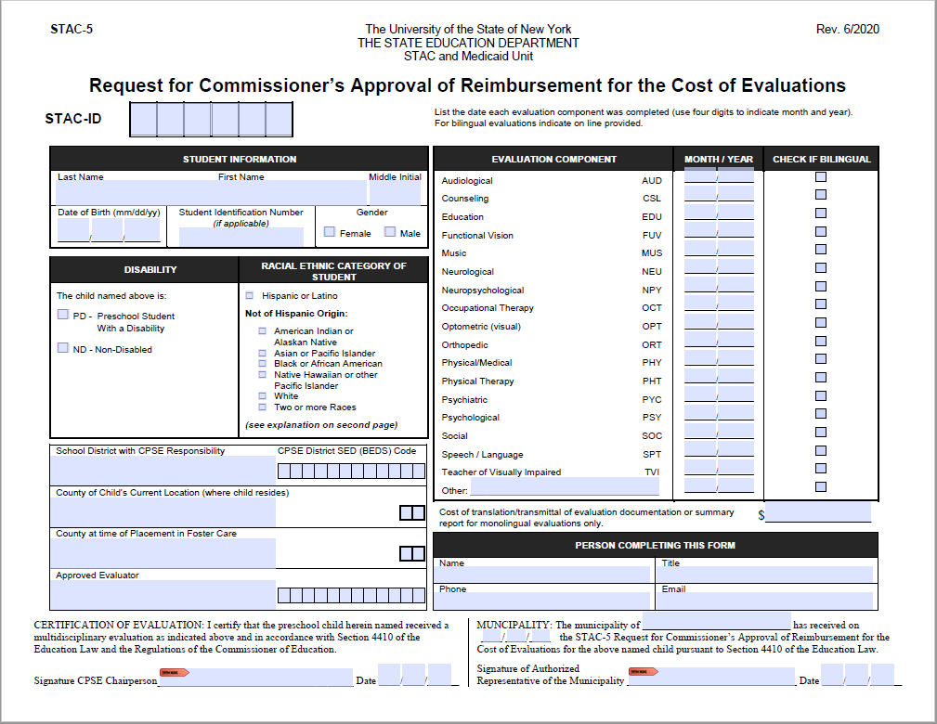
STAC-5 Form – Request for Commissioner's Approval of Reimbursement for Evaluations
21

Slide 22
Processing “OTHER” Evaluations
Many “OTHER” evaluations are typically processed as part of a recognized evaluation component listed in our “Glossary of Terms” (see list on following slide).
When “OTHER” evaluations are reimbursed as a stand-alone evaluation, these specialty evaluations require a special explanation from the CPSE attached to the STAC-5 (identify type on form).
All “OTHER” evaluations are reviewed and processed manually by the STAC Unit.
Counseling, Functional Vision, Music Therapy, and an evaluation by a teacher of the blind/visually impaired are no longer considered “Other” Evaluations.

Slide 23
Recognized “OTHER” Evaluation Components
Evaluation for:
Adaptive PE
Art Therapy/Play Therapy
Augmented Communication
Cleft Palate
Physical Coordination & Balance
Developmental Assessment
Ear/Nose/Throat
Feeding
Oral Motor
Orientation and Mobility
Eval by Teacher of the Deaf
May be part of:
Physical/Medical or PT Eval
Psychological Eval
Speech/Language Eval
Physical/Medical Eval
Physical/Medical or PT Eval
Physical/Medical Eval
Physical/Medical Eval
Physical/Medical or Speech/Language
Physical/Medical Eval
Psychiatric, Optometric, OT, PT or
Audiological Eval
Education Eval

Slide 24
PRESCHOOL PROCESSING Placement for Educational Services – STAC-1
Placement by Committee on Preschool Special Education (CPSE).
STAC-1 generated by school district, authorized by Board of Education Representative, and sent to municipality for signature.
Municipality authorizes STAC-1 and forwards info to STAC Unit – either electronically (through the Online or FTP process) or hard copy (as necessary).
STAC-3 report generated for all approved STAC-1’s; approval notices sent to School District, County and SED-approved provider.
NOTE: Child specific STAC-3 is available to view and print via DQPRT screen, otherwise a summary report is made available inside the SED FTM outbasket once every 4 weeks. The filename begins with EFHMAIL.

Slide 25
PRESCHOOL PROCESSING Placement for Educational Services – STAC-1
Related Services must list begin/end dates, type, number of sessions, and rate (county rate is a cap).
Coordination as a related service requires two other related services approved, not allowed if concurrent with SEIS approval (included in SEIS rate).
SEIS must list begin/end dates and number of sessions and rate.
Center based program begin/end dates generate an FTE.

Slide 26
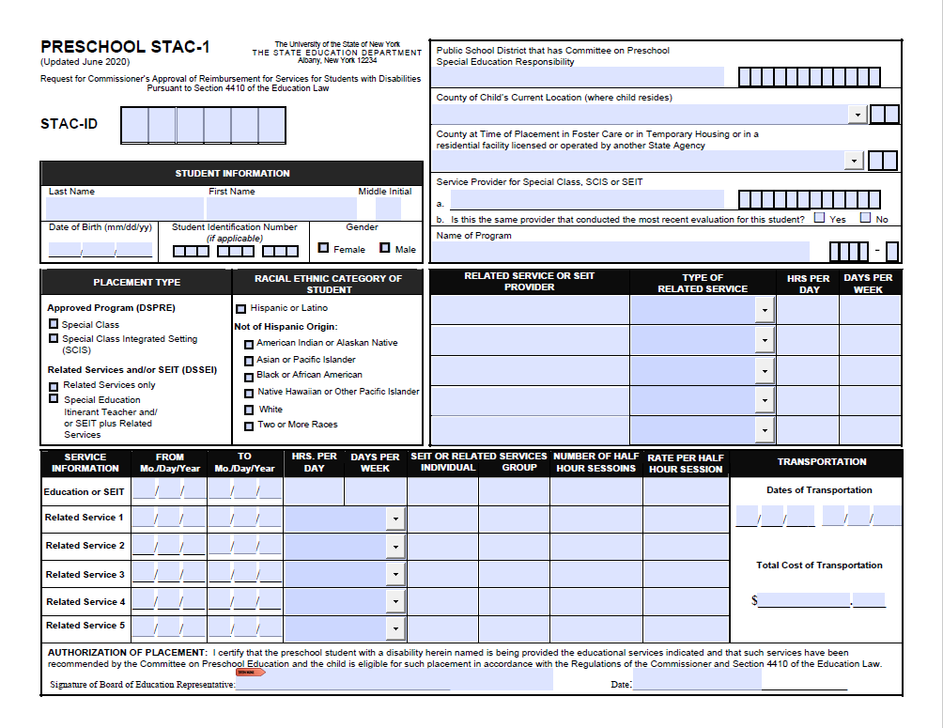
Preschool STAC-1 Form - Request for Commissioner’s Approval of Reimbursement for Services for Students with Disabilities Pursuant to Section 4410 of the Education Law

Slide 27
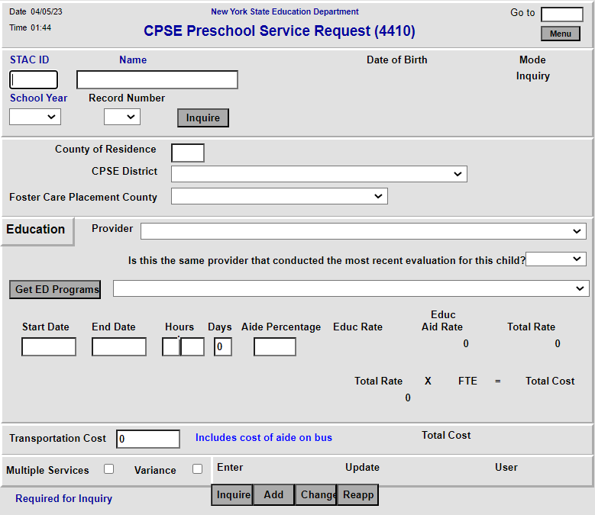
DSPRE Screen – Center Based Programs

Slide 28
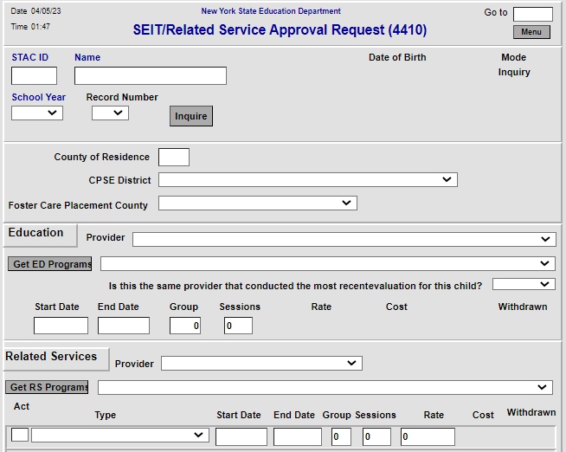
DSSEI Screen – SEIS and Related Services
SEIS Services
For STAC approval, County is provider for all Related Services

Slide 29
Multiple Service STAC’s
Dual services are a combination of two concurrent placements. Examples include:
Two half-time center-based placements (possibly one special class combined with a second integrated class).
Half-time center-based placement and SEIS services.
Half-time center-based placement and an additional related services not included as part of the center-based placement.
Note: Both placements not to exceed 5 hours/day.
A STAC-1 needs to be completed for each placement. Each STAC-1 needs to be clearly marked as a “Multiple Service.”

Slide 30
Requesting 1:1 Aides
With the addition of the Aide Percentage field in EFRT, 1:1 Aide forms are no longer required for full time aides nor partial 1:1 aides (including shared 1:1 aides).
Users may enter an aide percentage from 1 to 100 percent (whole numbers only).
Leave Aide Percentage field blank, if a student does not require an aide. Zero will not be accepted and will result in an error message.
1:1 aide as a related service may be entered into EFRT via the DSSEI screen without special processing by STAC.

Slide 31
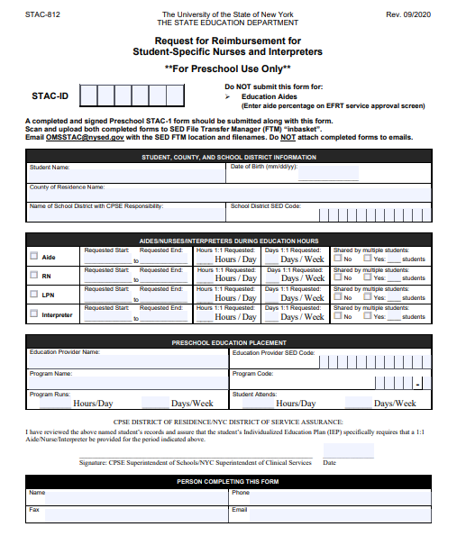
STAC- 812 Form - Request for Reimbursement for Student-Specific Nurses and Interpreters **For Preschool Use Only**
To be used for RN/LPN/Interpreters in a Preschool Special Class (or SCIS) setting.
Costs are calculated based on enrollment through the DSPRE screen in EFRT.
EXCEPTION: RN/LPN/Interpreters may be entered in as a related service under specific conditions. Each of the following must be true:
Student’s IEP lists the use of an RN/LPN/Interpreter.
Student is NOT enrolled in a Special Class (or SCIS) program.
Student is receiving SEIS and/or related services.

Slide 32
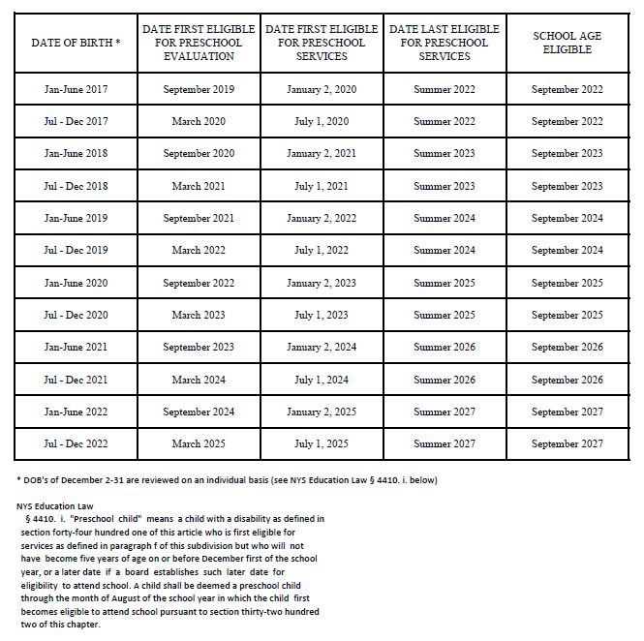
Age Eligibility for 4410 Preschool
This chart is an extension of the information contained in the Policy memo on Evaluation of 3 and 4 year olds.
The memo is posted on the STAC website under Pre-school / Preschool Policy.
STACs submitted for evaluations of children entering kindergarten in September must indicate evaluation dates prior to August in order to be reimbursed via the STAC process.

Slide 33
PRESCHOOL PROCESSING Rate Sources
Evaluation (DOH)
Related Service (County)
Special Education Itinerant Service (RSU)
Center Based Program (RSU)
Aide (DOB)
Nurse
1:1 Aide
Interpreter
Transportation (DOB)

Slide 34
STAC-710 Form – County List of Approved Rates for Preschool Related Services

Slide 35
PRESCHOOL PROCESSING Claiming
Counties are responsible for claiming costs associated with preschool services provided.
Automated Voucher Listings (AVL) are created by the STAC Unit for counties to use for claiming.
Center based programs: verify enrollment (FTE) and costs paid.
SEIS and Related Services: verify sessions and costs paid.
Transportation: verify actual cost.
Claim via FTP file or directly on the STAC Online (EFRT) System, using the DVPRS screen.
Once preschool services have been delivered and paid; a county may claim costs.

Slide 36
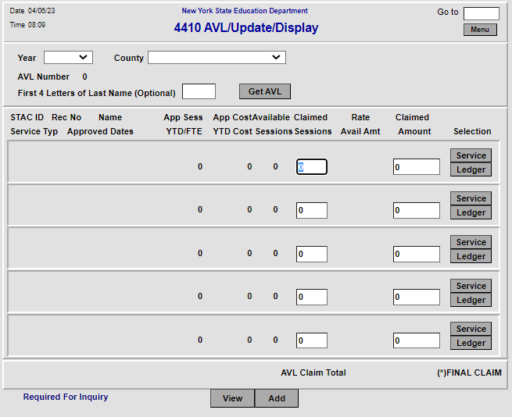
DVPRS – 4410 Preschool Service Verification

Slide 37
PRESCHOOL PROCESSING Statute of Limitations
All preschool service and evaluation approvals have a three-year statute of limitations.
2019-20 school year will close out June 30, 2023.
Final AVLs for 2019-20 school year will be prepared in mid-May 2023 and MUST be submitted to STAC for processing by close of business June 30, 2023.
Change in tuition rate supersedes the Statute of Limitations.
Reductions recovered without county action.
County must claim additional amounts made available by close of school year following the school year in which the rate change was applied.

Slide 38
PRESCHOOL PROCESSING Payments
STAC Unit processes the returned AVL (FTP file or Online version) completed by the county.
State reimbursement rate is 59.5%.
STAC Unit collects proper signature through separate online system.
Individual authorized to sign for municipality should be a different person than who processes the AVL.
Registration and use instructions are posted on STAC website under Preschool AVL page:
Electronic Signature for Preschool AVL memo
Electronic Signatures should be submitted as follows:
FTP Verifications: after receiving email notification to proceed.
Online Verifications: immediately after claim submission.

Slide 39
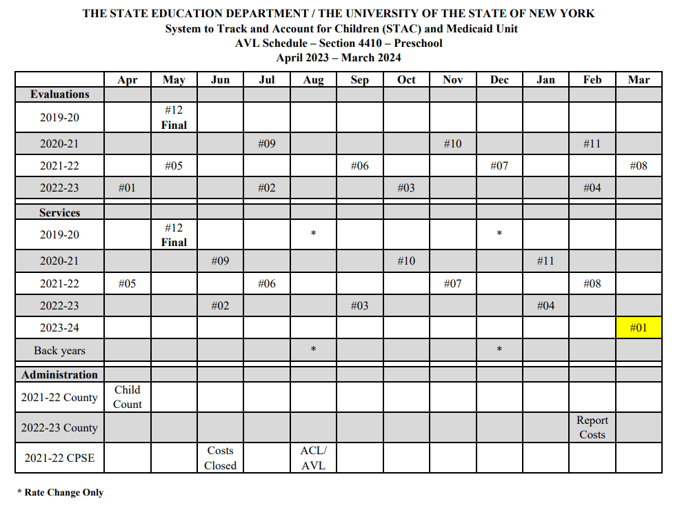
PRESCHOOL PROCESSING AVL Schedule
Schedule lists claiming opportunities by school year and type, as well as important timeframes for the administrative cost processes.
“Back years” notates when tuition rate change AVLs will be made available for school years that are beyond the statute of limitations.
Posted on STAC website under Pre-school / Preschool AVL.

Slide 40
AVL Adjustments
4408 Chargeback
10% of verified July/August Special Education service costs for children ages 5-21 (multiple years initial/adjustment chargeback).
Deducted from AVL #01 and additional current year AVLs, until recovered.
Medicaid Payments
Non-federal share of Preschool Supportive Health Services Program (PSHSP) services and evaluations reimbursement is recouped from 4410 funds.
Recent payments adjusted on each current year AVL.

Slide 41
AVL Adjustments, continued
Transportation Cap
Actual cost is reported, but total reimbursed cost can not exceed (trips x rate).
Trips generated by verified services.
Foster Care
Local 40.5% share of costs charged back to county of origin, on the following AVL after servicing county is reimbursed at 100%.
State Operated Schools
Rome Preschool costs paid by NYS; 40.5% local share charged back to county of origin.

Slide 42
ANNUAL PRESCHOOL PROCESSES County Administrative Costs
Each County reports Administrative Costs associated with running its Preschool program in March.
Report containing unduplicated count of Preschoolers Generating Administrative Costs is generated in April.
Counties receive lesser of reported costs or $75 per child.

Slide 43
ANNUAL PRESCHOOL PROCESSES CPSE Administrative Costs
State Aid provides CPSE costs submitted by districts through the State Aid Management System (SAMS) – Supplemental Schedules 31-34.
Same report containing unduplicated count of Preschoolers Generating Administrative Costs generated for County Administrative Costs is also used for CPSE Administrative Cost reimbursement calculation.
Per pupil cost calculated and approved by SED.
Administrative Cost Listing (ACL) prepared for districts to submit to counties to reimburse their CPSE costs.
County submits matching AVL to STAC Unit for CPSE costs they have paid to a district (59.5% aid rate).

Slide 44
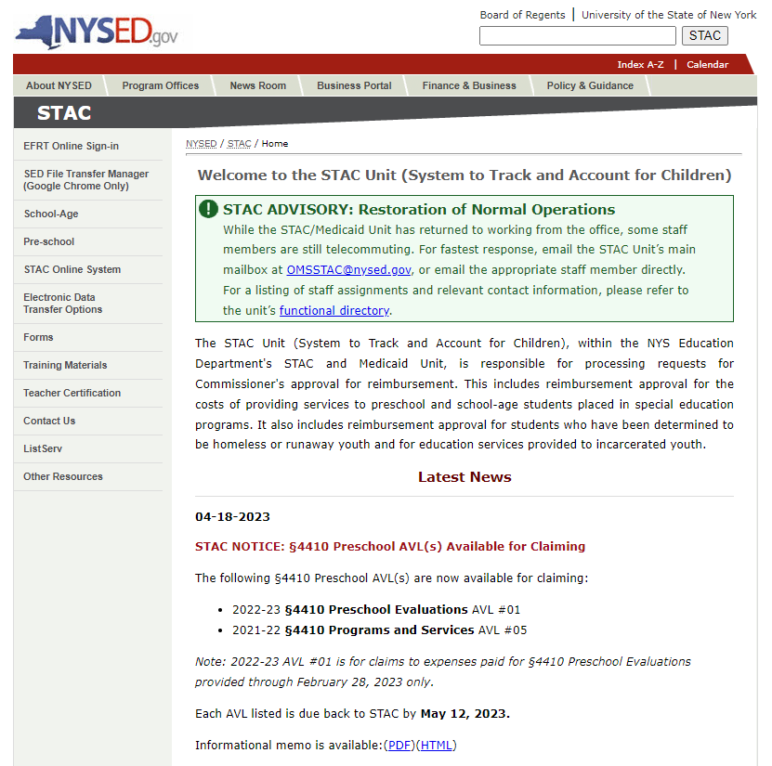
STAC Unit - Preschool News
STAC Unit routinely posts updates to the STAC website. Postings are listed on the main page under the “Latest News” section. Each post is dated with the most recent post at the top and an archive is available.
In addition, each preschool posting is forwarded to recipients of the STACPRE LISTSERV distribution list.
Every individual that works on Preschool for a municipality should subscribe to the STACPRE LISTSERV.

Slide 45
Subscribe to the STAC LISTSERV
Register to Receive Information from the STAC and Medicaid Unit
You can receive notification by electronic mail of the latest memoranda and other updates by subscribing to one or more of our LISTSERVs:
Preschool (ages 3-5) https://www.oms.nysed.gov/stac/listserv/ listserv_preschool_registration.html
SCHOOL-AGE (ages 5-21) https://www.oms.nysed.gov/stac/listserv/ listserv_schoolage_registration.html
Provider (SED-Approved Education Providers) https://www.oms.nysed.gov/stac/listserv/ listserv_provider_registration.html
Medicaid in Education (P/SSHSP) https://www.oms.nysed.gov/medicaid/listserv_registration.html
To Subscribe to the Preschool ListServ:
To begin a subscription, please send an e-mail message to LISTSERV@LISTSERV.NYSED.GOV
The body of the message must read: SUBSCRIBE STACPRE firstname lastname
You will receive a welcome message when you subscribe. Please save this message for future reference, especially if this is the first time you are subscribing to an electronic mailing list.
Many Spam Filters and Virus software may block messages from LISTSERVs. Once you have subscribed, please notify your technical support staff that these notices with attachments will be coming from STACPRE@LISTSERV.NYSED.GOV.
To Unsubscribe:
If at any time you want to stop receiving announcements, you may be removed from the list by sending the following command to LISTSERV@LISTSERV.NYSED.GOV
The body of the message must read: SIGNOFF STACPRE GLOBAL

Slide 46
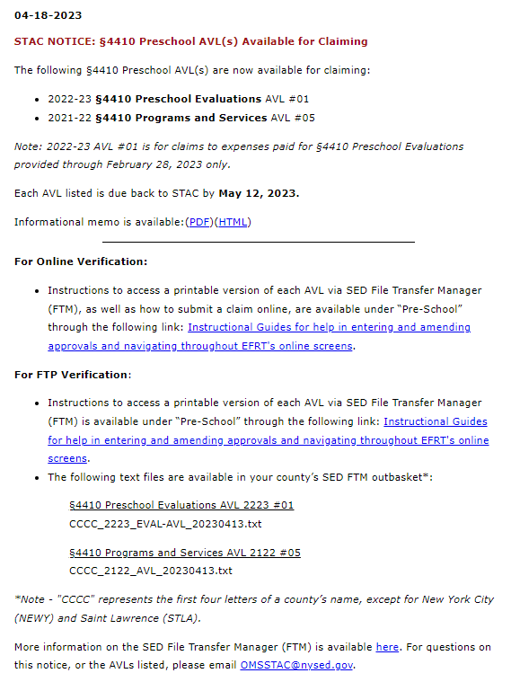
STACPRE Listserv: Preschool AVL Available for Claiming
This type of message advises:
A list of each AVL available for claiming.
Due date back to STAC.
Information memo.
Link to the Instructional Guides posted on the STAC webpage.
(For FTP verification users only)
The name of AVL text file uploaded to a county’s SED FTM outbasket.

Slide 47
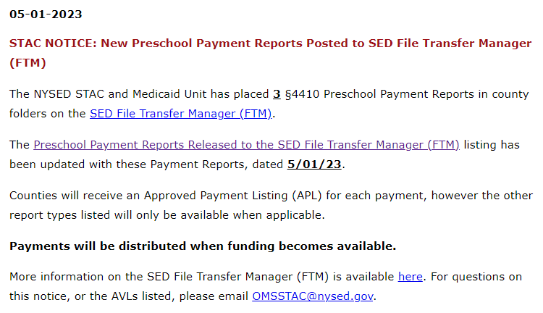
STACPRE Listserv: Preschool Payments Posted to SED FTM
This type of message advises:
Number of Preschool Payment Reports posted to a county’s SED FTM outbasket.
Upload date(s)
Includes a link to the list of Preschool Payment Reports Released to the SED FTM.
Also available under the Preschool AVL page of STAC website.

Slide 48
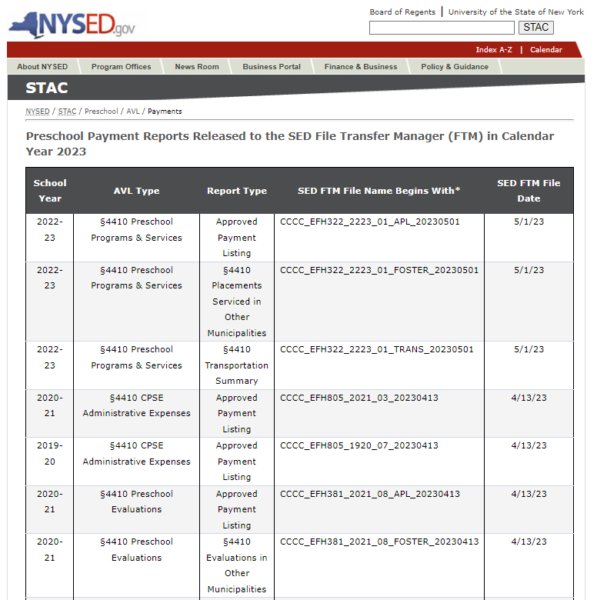
Preschool Payment Reports Released to SED FTM in Calendar Year 2023
Calendar of Payment Reports is organized by JAN – DEC calendar year.
Other calendar years are available at the bottom of the screen.
Most recent reports are listed at the top of the list.
Information may be used to locate specific reports inside a counties SED FTM outbasket.

Slide 49
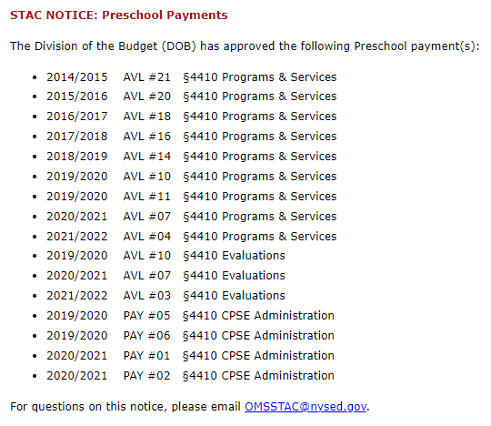
STACPRE Listserv: Preschool Payments Posted to SED FTM
This type of message advises:
NYS Division of the Budget has approved funding for the AVLs listed.
Payments are processed through another SED office.
Generally, counties should begin to receive funds within 2-3 weeks of this notice.

Slide 50
Preschool Resources
STAC Unit
Main Telephone Number | (518) 474-7116
General Email Address | OMSSTAC@nysed.gov
All documentation containing personally identifiable information (PII) for students must be transmitted to the STAC and Medicaid Unit using the SED File Transfer Manager.
Preschool Supervisor | Robert Wojtkiewicz
Robert.Wojtkiewicz@nysed.gov
Preschool STAC & AVL Process | Nicholas Thayer
Nicholas.Thayer@nysed.gov
Office of Special Education – Preschool Policy Unit
Main Telephone Number | (518) 473-6108
Email Address | SPECED@nysed.gov

Slide 51
Preschool Resources
Evaluation Policy Memo
https://www.oms.nysed.gov/stac/preschool/policy/eval3-4yr803.pdf
SEIT / Related Service Policy Memo
https://www.oms.nysed.gov/stac/preschool/correspondence/SEIS_Data_Collection_Guidance.pdf
Transportation Policy Memo
https://www.p12.nysed.gov/specialed/publications/preschooltrans-811.htm
STAC Online System Request for Access Form
https://www.oms.nysed.gov/stac/forms/stac_access_form.pdf
https://www.oms.nysed.gov/stac/stac_online_system/stac_access_notice_consultants.html
SED File Transfer Manager Access Form
https://www.oms.nysed.gov/stac/forms/stac-603_form_authorization_ftp.pdf

Slide 52
Thank you for attending this training.
A downloadable version of this presentation is available on the STAC website:
https://www.oms.nysed.gov/stac/training_materials/
Rev. May 2023

