Slide 1
Introduction to Preschool STAC Processing
STAC Homepage: http://www.oms.nysed.gov/stac/
Rev. May 2016

Slide 2
STAC
System to Track and Account for Children (STAC)
STAC and Medicaid Unit is the unit within the NYS Education Department responsible for processing requests for Commissioner's approval for reimbursement. This includes reimbursement approval for the costs of providing services to preschool and school-age students placed in special education programs at public and SED-approved private schools, special-act school districts, BOCES, and at state-supported and state-operated schools for the deaf and blind. It also includes reimbursement approvals for students who have been determined to be homeless or runaway youth and for education services provided to incarcerated youth. This year STAC will process over 270,000 requests for reimbursement to school districts and municipalities.

Slide 3
STAC ACRONYMS AND COMMON TERMS
APR Approved Payment Report
AVL Automated Voucher Listing
CPSE Committee on Preschool Special Education
FTE Full Time Equivalent
IEP Individualized Education Program
LEA Local Educational Agency
P-12 NYSED Special Education Office
SEIS Special Education Itinerant Teacher Services
STAC System to Track and Account for Children

Slide 4
Section 4410 Preschool Reimbursements
PRESCHOOL SERVICES:
CENTER-BASED SERVICES
SEIS SERVICES
RELATED SERVICES
TRANSPORTATION
PRESCHOOL EVALUATIONS
ADMINISTRATIVE COSTS:
CPSE ADMINISTRATIVE COSTS
COUNTY ADMINISTRATIVE COSTS

Slide 5
Basic Process – Preschool Services and Evaluations
CPSE evaluates, determines disability and service needs
Programs are approved by NYSED Office of Special Education
Approved Child Evaluation or Service Record on STAC System
County submits STAC record, contracts / pays providers
Rate is added for programs, services
County verifies services delivered and paid to generate 59.5% reimbursement

Slide 6
Electronic Record Access
STAC Online (EFRT) System
Review, add or verify approvals (providers review only)
User IDs must be authorized by District Superintendent (agency directors for providers)
User IDs and passwords must not be shared
STAC Unit can suspend rights when aware of violations
Use request form on website to add new users or delete users
Separate forms for employees and third-party consultants
Consultant form should be used to give BOCES users district rights
New online functionality allows District Superintendents to renew or suspend users directly
FTP site
Submit bulk files – format available on STAC website
Download summary files
Two accounts required to create file:
FTP username and password
EFRT Usercode and password
New GoAnywhere secure FTP process for sending and receiving files:
FTP Authorization Form required: http://www.oms.nysed.gov/stac/forms/stac-603_form_authorization_ftp.pdf
Register and access through GoAnywhere web client
Or access through FTP client using SFTP protocol.

Slide 7
STAC Online System Resource Screens
DQCLD List of child’s STAC service approvals
DQEVL List of child’s STAC evaluation approvals
DQAPP List of agency’s approvals by year, provider, placement type
DQPRT Print screen for STAC-3 approvals
DQPR5 Print screen for STAC-5A approvals
DQPRG Provider / Program Search
DRPRS STAC AVL Information
DVPRS Preschool service verification
XAUTH STAC Online Users
XTEND Access Renewal/Suspension Screen
7

Slide 8
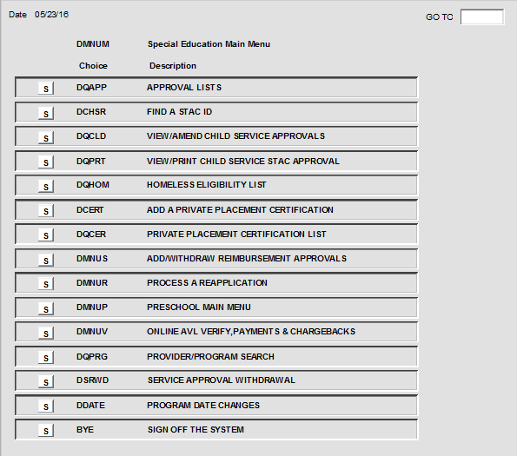
EFRT Preschool Menu - County

Slide 9
PRESCHOOL PROCESSING School District Role
STAC approval forms are created by school districts based on the student’s IEP.
There are separate STAC forms for Preschool Services (STAC-1) and Preschool Evaluations (STAC-5).
Paper STAC forms are completed and forwarded to the district’s respective county.
School district submits a signed STAC-3 to the county for all
revisions to preschool approvals.

Slide 10
PRESCHOOL PROCESSING School District Role
The CPSE is required to report whether service provider also conducted the most recent evaluation.
Applies to center-based class (special class and SCIS) and SEIS placements – does not apply to related services
District includes answer on STAC-1 submitted to county
County submits to SED with reimbursement approval request
Answer of “Y” or “N” does not affect approval, but must be included

Slide 11
PRESCHOOL PROCESSING County Role
Counties review and approve STAC forms submitted by School Districts
Counties electronically sign and forward the approved STAC forms either directly on the STAC Online system or through the FTP Batch file processing
STAC Unit reviews and processes certain approvals (Assistive Technology, partial aide/nurse/interpreter)
Counties electronically process all preschool amendments submitted to them by the school district

Slide 12
PRESCHOOL PROCESSING Provider Role
Preschool SED-approved providers and evaluators (with a STAC online user code and password) can VIEW all classroom and SEIS STAC approvals associated with their agency
Preschool SED-approved providers and evaluators (with a STAC online user code and password) cannot ADD or AMEND any STAC approvals on the system
Related Service therapists cannot view approvals on the STAC system

Slide 13
PRESCHOOL PROCESSING Requests / Notices of Approvals
STAC-5 – Request for Approval (evaluations)
STAC-5A – Notice of Approval (evaluations)
STAC-1 – Request for Reimbursement Approval (education services and transportation)
STAC-3 – Notice of approval (for STAC-1s)

Slide 14
Data Submission to STAC Unit
Online
Service approvals (classes, SEIS, related services)
AVL verification of services for payment
FTP
Evaluation approvals
Service approvals (classes, SEIT, related services)
AVL verification of services and evaluations for payment
Paper
Evaluation approvals and verification for payment
Paper, additional review by STAC Unit
Partial 1:1 Aides (1/2 time aide processing online 7/1/15)
Interpreter, RN, LPN
Other Evaluations, second psychological or social
Related Service – Assistive Technology
“Triple” Services

Slide 15
Protecting STAC Data and Personally Identifiable Information (PII)
Family Educational Rights and Privacy Act (FERPA), Health Insurance Portability and Accountability Act (HIPAA), NYS Personal Privacy Protection Law and other statutes all require that PII is kept secure and only shared on a “need to know” basis
Exchanging student data with the STAC Unit:
Fax during business hours and advise recipient when will be sent
Emails with PII other than STAC ID need to be encrypted with password sent separately
Paper documents sent US Mail 1st class/priority, or other service with tracking (e.g., UPS, FedEx, DHL)
Use the STAC Online (EFRT) System and FTP site – log out when not active
When calling STAC Unit be prepared with your STAC Online User Code and password to confirm authorization to share data

Slide 16
PRESCHOOL PROCESSING STAC-5 Evaluations
Referred for evaluation by Committee on Preschool Education (CPSE)
STAC-5 form generated by School District, authorized by the district and sent to municipality for signature
Municipality authorizes STAC-5 and forwards info to STAC Unit – either in hard copy or electronically
STAC-5A evaluation approval is available for printing from the STAC mainframe using Screen DQPR5
NOTE: Functional Behavioral Assessment (FBA) and Applied Behavioral Analysis (ABA) are methods of conducting evaluations, not evaluation types.
16

Slide 17
Preschool Evaluation Rates
Preschool Evaluation Rates are developed by the New York State Department of Health
Issued through the NYS Education Department’s Rate Setting Unit
Applicable rate is determined by the county of residence of the student, not by the county of the approved evaluator
17

Slide 18
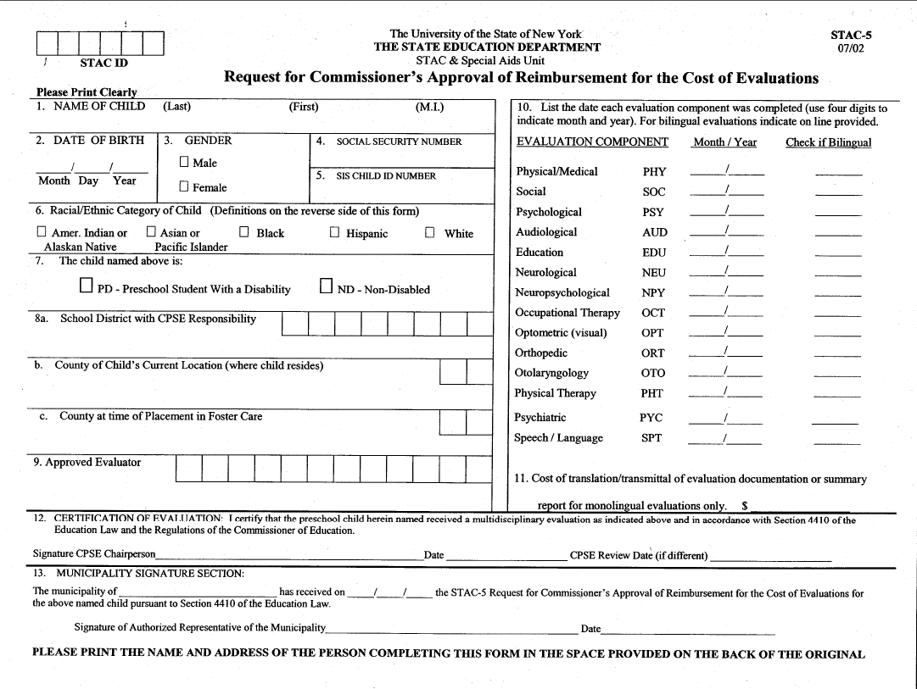
xxxxxxxxxxxxxx
18

Slide 19
Processing “OTHER” Evaluations
Many “OTHER” evaluations are typically processed as part of a recognized evaluation component listed in our “Glossary of Terms” (see list on following slide)
When “OTHER” evaluations are reimbursed as a stand alone evaluation, these specialty evaluations require a special explanation from the CPSE attached to the STAC-5 (identify type on form)
All “OTHER” evaluations are reviewed and processed manually by the STAC Unit
Counseling, Functional Vision, Music Therapy, and an evaluation by a teacher of the blind/visually impaired are no longer considered “Other” Evaluations

Slide 20
Recognized “OTHER” Evaluation Components
Evaluation for:
Adaptive PE
Art Therapy/Play Therapy
Augmented Communication
Cleft Palate
Physical Coordination & Balance
Developmental Assessment
Ear/Nose/Throat
Feeding
Oral Motor
Orientation and Mobility
Eval by Teacher of the Deaf
May be part of:
Physical/Medical or PT Eval
Psychological Eval
Speech/Language Eval
Physical/Medical Eval
Physical/Medical or PT Eval
Physical/Medical Eval
Physical/Medical Eval
Physical/Medical or Speech/Language
Physical/Medical Eval
Psychiatric, Optometric, OT, PT or
Audiological Eval
Education Eval

Slide 21
PRESCHOOL PROCESSING Placement for Educational Services – STAC-1
Placement by Committee on Preschool Special Education
STAC-1 generated by school district, authorized by BOE, and sent to municipality for signature
Municipality authorizes STAC-1 and forwards to STAC Unit, either in hard copy or electronically
STAC-3 generated for all approved STAC-1’s; approval notices sent to School District, County and SED-approved provider
NOTE: STAC-3 is available for viewing and printing via DQPRT – otherwise, these are mailed on a monthly basis.

Slide 22
PRESCHOOL PROCESSING Placement for Educational Services – STAC-1
Related Services must list begin/end dates and type, number of sessions and rate (county rate is a cap)
Coordination as related service requires two other related services approved, not allowed concurrent with SEIS approval (included in SEIS rate)
SEIS must list begin/end dates and number of sessions and rate
Center based program begin/end dates generate an FTE

Slide 23
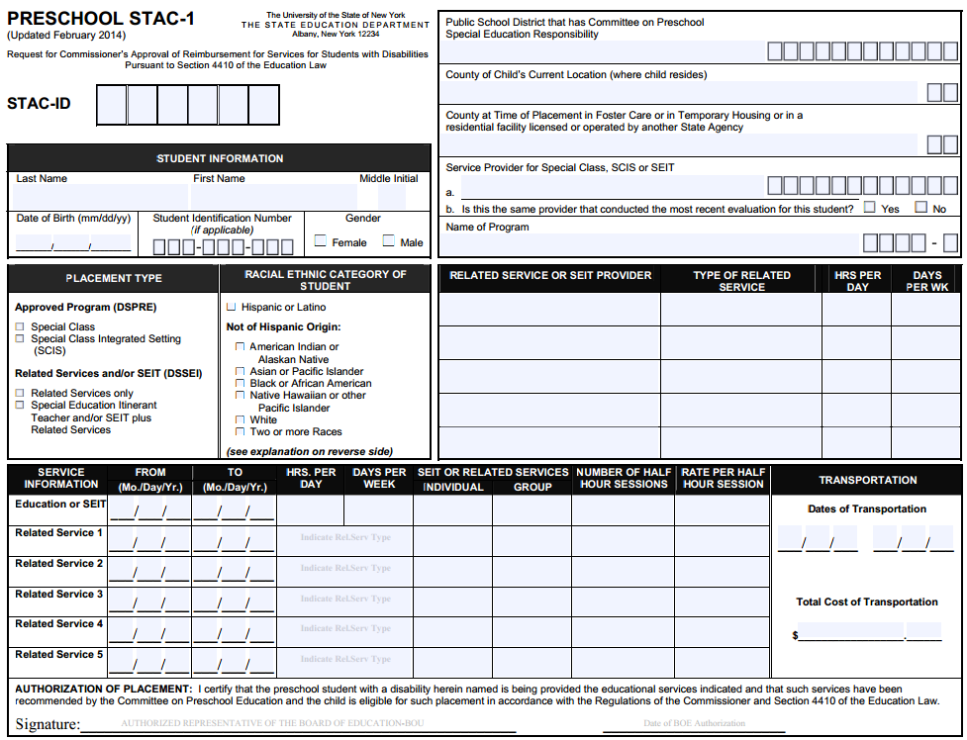
STAC-1 Submitted from District to County

Slide 24
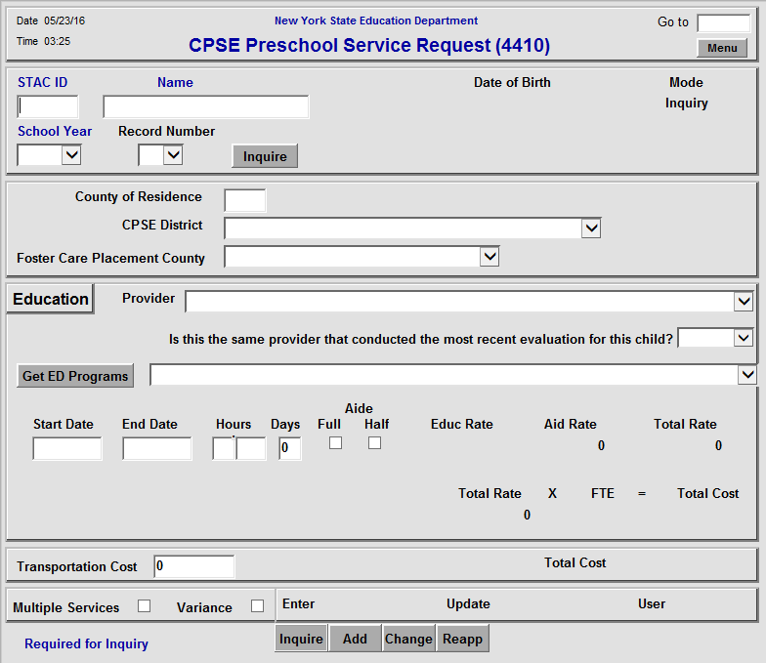
DSPRE Screen – Center Based Programs

Slide 25
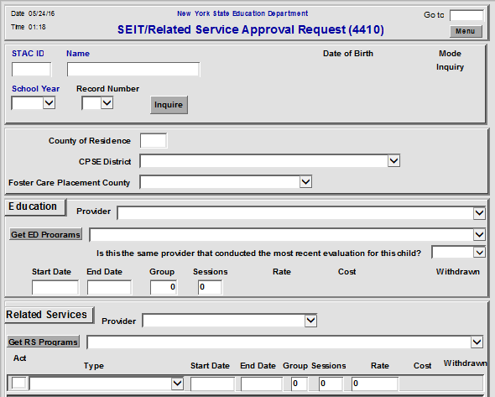
DSSEI Screen – SEIS and Related Services
SEIS Services
For STAC approval, County is provider for all Related Services

Slide 26
Multiple Service STAC’s
Dual services are a combination of two concurrent placements. Examples include two half-time center-based placements (possibly one special class combined with a second integrated class), a half-time center-based placement and SEIS services, or a half-time center based placement an additional related services not included as part of the center-based placement. Two placements not to exceed 5 hours/day.
A STAC-1 needs to be completed for each placement. Each STAC-1 needs to be clearly marked as a “Multiple Service.”

Slide 27
Requesting 1:1 Aides
1:1 Aide forms are not required for full time aides, nor 1:1 related service aide.
Effective 7/1/15– option for county to add 50% aide without filing paper form with STAC Unit
A “Request for Reimbursement for Partial 1:1 Aide, 1:1 Nurse, 1:1 Interpreter” form must be completed for:
Part-time 1:1 Aides; excluding Half-time Aide
All shared 1:1 Aides; excluding Half-time Aide
All 1:1 Nurses and Interpreters (Full time and part time)
Must indicate RN or LPN on form
27

Slide 28
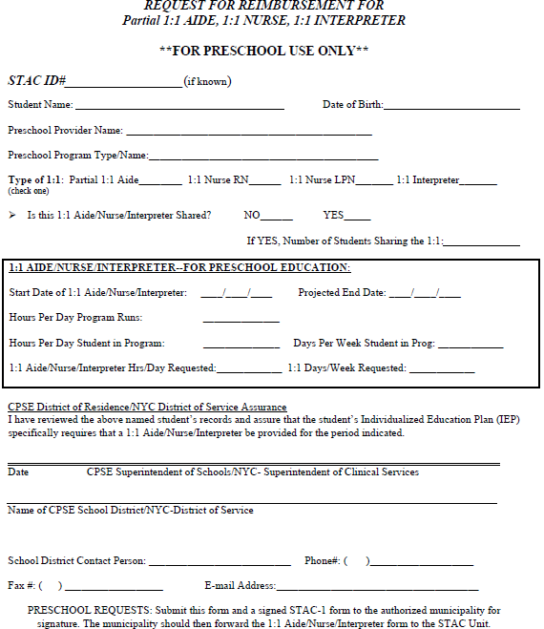

Slide 29
Age Eligibility for 4410 Preschool
Evaluations
Born Jan – Jun 2013: September 2015
Born Jul – Dec 2013: March 2016
August evaluation not reimbursable when eligible for school age services in September
Services
Born Jan – Jun 2012: January 2015 - August 2017
Born Jul – Dec 1, 2012: July 2015 – August 2017
Born Dec 2011 may be eligible until August 2017

Slide 30
PRESCHOOL PROCESSING Rate Sources
Evaluation (DOH)
Related Service (County)
Special Education Itinerant Teacher (RSU)
Center Based Program (RSU)
Aide (DOB)
Nurse
1:1 Aide
Interpreter
Transportation (DOB)

Slide 31
Related Service Rates Form

Slide 32
PRESCHOOL PROCESSING Claiming
Counties are responsible for claiming preschool services costs
Automated Voucher Listings (AVL) are created by the STAC Unit for counties to use for claiming
Center based programs verify enrollment (FTE)
SEIS and Related Services verify sessions
Transportation verify actual cost
Claim via FTP file or directly on the STAC Online System, using the DVPRS screen
Once preschool services have been delivered and paid for, a county can claim costs

Slide 33
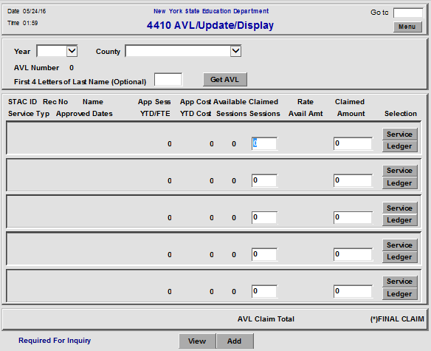
DVPRS – 4410 Preschool Service Verification

Slide 34
PRESCHOOL PROCESSING Statute of Limitations
All preschool service and evaluation approvals have a three-year statute of limitations for STAC’ing and claiming
2013-14 processing will close out June 2017 – last AVL will be prepared in May 2017
A rate change supersedes the statute of limitations
Reductions recovered without county action
County must claim additional amounts made available by close of school year following the school year in which the rate change was made

Slide 35
PRESCHOOL PROCESSING Payments
STAC Unit processes the returned AVL (FTP file or Online version) completed by the county
STAC Unit collects proper signature through online system
Individual authorized by municipality representative, must be different person than processes the AVL
http://www.eservices.nysed.gov/countylogon/
NOTE: There is an established AVL schedule created by the STAC Unit for all Preschool AVLs (both Evaluation and Service AVLs) - See STAC webpage
Reimbursed at 59.5%

Slide 36
AVL ADJUSTMENTS
4408 Chargeback
10% of verified July/August Special Education service costs for children ages 5-21 (multiple years initial/adj chargeback)
Deduct from AVL#1, additional AVLs until recovered
Medicaid Payments
Non-federal share of Preschool Supportive Health Services Program (PSHSP) services and evaluations reimbursement is from 4410 funds
Recent payments adjusted on each current year AVL

Slide 37
AVL ADJUSTMENTS, continued
Transportation Cap
Actual cost is reported, but total reimbursed cost can not exceed (trips x rate)
Trips generated by verified services
Foster Care
Local 40.5% share of costs charged back to county of origin, service county reimbursed @ 100%
State Operated Schools
Rome Preschool costs paid by NYS, 40.5% local share charged back to county of origin

Slide 38
ANNUAL PRESCHOOL PROCESSES County Administrative Costs
Counties report Administrative Costs in March
Unduplicated count of Children with services or evaluations made in April
Counties receive lesser of reported costs or $75 per child

Slide 39
ANNUAL PRESCHOOL PROCESSES CPSE Admin Costs
State Aid provides CPSE costs submitted by districts on the SAMS system---Schedules 31-34. (2014-15 CPSE Excess Admin online data filed by May 2016)
Count of children for CPSE taken from State data
Statewide average cost per child calculated
Administrative Cost Listing (ACL) prepared for districts to submit to counties to reimburse their CPSE costs
County submits matching AVL to STAC Unit for CPSE costs they have paid to a district (59.5% aid)

Slide 40
Preschool Resources
STAC Unit (518) 474-7116
Preschool Supervisor – Sheila Costa
AVL Processing – Bob Wojtkiewicz
Office of Special Education (518) 473-6108
Policy questions – Elina Tsenter
STAC Preschool Listserv
http://www.oms.nysed.gov/stac/listserv/
STAC Homepage
http://www.oms.nysed.gov/stac/

Slide 41
Preschool Resources
SEIT / Related Service Policy Memo
http://www.oms.nysed.gov/stac/preschool/correspondence/SEIS_Data_Collection_Guidance.pdf
Evaluation Policy Memo
http://www.oms.nysed.gov/stac/preschool/policy/eval3-4yr803.pdf
Transportation Policy Memo
http://www.p12.nysed.gov/specialed/publications/preschooltrans-811.htm
STAC Online System Request for Access Form
http://www.oms.nysed.gov/stac/forms/stac_access_form.pdf
http://www.oms.nysed.gov/stac/forms/stac_access_form_consultants.pdf
Tuition Rates for Preschool Students with Disabilities
http://www.oms.nysed.gov/rsu/WorkgroupDocs/AReportPursuanttoChapter545oftheLawsof2013.pdf

